Slide 1
The FAWCO Target Water Project “Fun”-Raising Campaign
“Tastes”
“Cooks”
“Recipes”
“Ingredients
Notes:
Finally, The FAWCO Foundation is committed to helping FAWCO clubs raise money for the FAWCO Target Water Project, Tabitha Cambodia-Wells for Clean Water. We wanted to find something that would appeal to all “tastes”…We needed to “cook” up something that resonated with everyone, and give you a “recipe for success”. Big clubs or small, European or Asian, we know you have the “ingredients” that will make this campaign “rise to the top”!....
So the first thing that came to mind was ----food. And the second thing that came to mind was –fun.

Slide 2
Announcing...
Notes:
So today, The FAWCO Foundation is pleased to present

Slide 3
2011-2013
Notes:
“Well” Deserved Desserts !
A campaign that will assist FAWCO Clubs in their fundraising efforts.

Slide 4
$80,000
Notes:
The goal of this campaign in to involve as many clubs as possible and to raise as much money as we can for the FAWCO Target Water Project

Slide 5
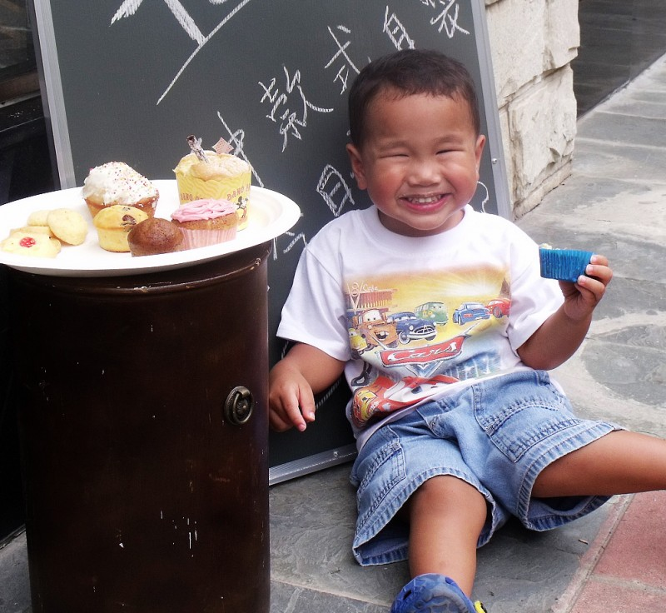
We all Love FOOD!
A Menu of Ideas – Something for Everyone!
The Foundation Will Provide Support
Notes:
The theme appeals to all of us –FOOD. The Foundation is rolling out a list of suggested events that you can take back to your boards for consideration. These fundraising ideas are delicious creations submitted by FAWCO members in response to a survey earlier this year. The mix of ideas supports large clubs and small and The Foundation will provide as much help as we can to make sure your event runs smoothly.

Slide 6
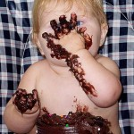
Recipe for Fun-Raising Success
1 Enthusiastic FAWCO Club
1 Mouth Watering Event
1 Very Important Project
Mix- Serve- SUCCESS!
Notes:
A Recipe for Fun Raising Success event preparation help kit will be available on The Foundation’s Website. The kit will include:
An in depth description of each of the fundraising ideas with “how to tips”
Critical information about the FAWCO Target Water Project
Press releases for newsletters and websites
Letter templates for sponsors suppliers
AND

Slide 7
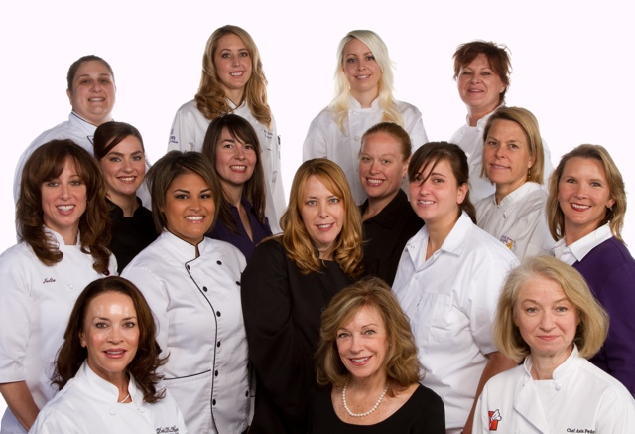
The FAWCO Foundation
Sous Chefs
Team
Notes:
Our special Foundation Well Deserved Desserts Sous Chefs- Volunteers assigned to assist with resources and information about each of the activities. Skype and email make it easy to work together! We’ll be there for you because “Well” Deserved Desserts is

Slide 8
This is NOT Your Mother’s Bake Sale
Notes:
NOT YOUR MOTHERS BAKE SALE!
Our survey found great excitement about this campaign but many said,
Please let someone else do the baking!
We have events that will bring out the foodie diva in those who love to cook
But we also have events on our list that require little or no cooking or baking at all.

Slide 9
The “WELL” WISHERS
Participation Program
Notes:
The Foundation recognizes that there are a few clubs that would like to participate in the Well Deserved Desserts fundraising campaign but local country laws prohibit them from club fundraising or clubs donating to outside projects . The Well Wishers program is designed to allow any club member’s individual donation to be counted toward their clubs participation in the Well Deserved Desserts campaign. More information will be available on The Foundation’s website.

Slide 10
The Mixing Bowl’s in Your Kitchen-Good Luck!
Notes:
The Well Deserved Desserts Campaign starts now and goes through December 2012. So start planning your event now.
Recognition Awards will be given for outstanding efforts at all levels. The final results will be announced at the FAWCO conference in March 2013.
Visit Foundation’s website often for updates and look for updates in The FAWCO Target Water Program monthly e-newsletter.
Thank YOU!

