Slide 1

A Fundraising Campaign to
Support the FAWCO Target Water Project in Partnership with The FAWCO Foundation
Benefiting
Tabitha Cambodia Wells for Clean Water
Notes:
Welcome to The FAWCO Foundation’s fundraising “no cook” cooking class.
Today we will be demonstrating the perfect recipe for fundraising success.
And no muss or fuss in the kitchen!
Before we get started lets spend a minute and talk about…

Slide 2
FUND
RAISING!
Notes:
This word elicits the same response as the word “volunteering” a big sigh, a shrug of the shoulder and the roll of the eyes.
But lets face it, fundraising is a big challenge these days. There’s too many worthy projects and yet too few new ideas.
The competition is fierce.
Successful fundraising runs the gamut between high tech social networking and people events with a personal touch.
How do we succeed?

Slide 3
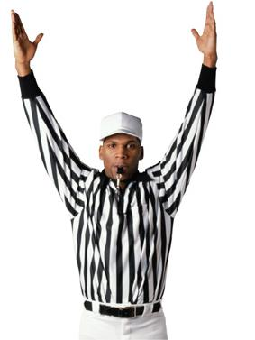

MAKE IT FUN!
SET A REASONABLE GOAL
FIND THE RIGHT PEOPLE
Notes:
We could spend hours dissecting this but it comes down to these three:
Making it Fun-
Start with a smile on your face-and keep it there
Keep everything moving forward and use positive energy
Say YES more than no
Setting a Reasonable Goal
Assess your Market- what has worked in the past? What do they love to do?
Analyze your risks/rewards –a Business plan event a basic one goes a long way into assuring success
Finding the Right People
Quality vs. quantity
Who is artistic, creative, outgoing, organized? Match the talents to the task
Let everyone know that there participation is important and each task is linked to the goal (that’s what the meetings are for!0
So lets talk about the campaign that The FAWCO Foundation has developed..

Slide 4
Putting the FUN back into
Fundraising
Notes:
Well Deserved Desserts! The FAWCO Foundation is committed to helping FAWCO clubs raise money for this project.
The theme appeals to all of us –DESSERTS These fundraising ideas were created by FAWCO members . The mix of ideas supports large clubs and small.

Slide 5

This is NOT Your
Mother’s Bake Sale
Notes:
We hope our FAWCO club “Foodies” will be a force behind these events.
Many of the events require a minimum of baking or cooking by club members. The idea that we’re presenting today takes no time at all.
We discussed various ideas for campaigns- we aren’t really ready for another marathon. No, we wanted something to appeal to everyone.

Slide 6
A Fundraising Campaign to
Support the FAWCO Target Water Project in Partnership with The FAWCO Foundation Benefiting
Tabitha Cambodia Wells for Clean Water
$89,000
Notes:
Over 30 clubs have raised $89,000 for the FAWCO Target Water Project. THANK you!
If your club hasn’t been able to come up with a fundraising idea perhaps one of the four Well Deserved Desserts modules on the FAWCO Foundation website can help you.

Slide 7
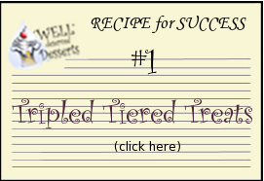
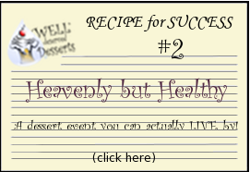
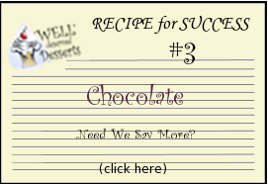
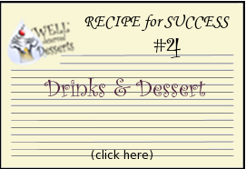
www.fawcofoundation.org
Notes:
.
Read through them to find one (or more ) that will resonate with your club.
In addition to the Recipe tip sheet, we have provided suggest letters, press releases, and other templates that you might find useful for organizing your event.
Download the documents and Customize” As with any good recipe you can customize the event to suit your clubs style or tastes

Slide 8
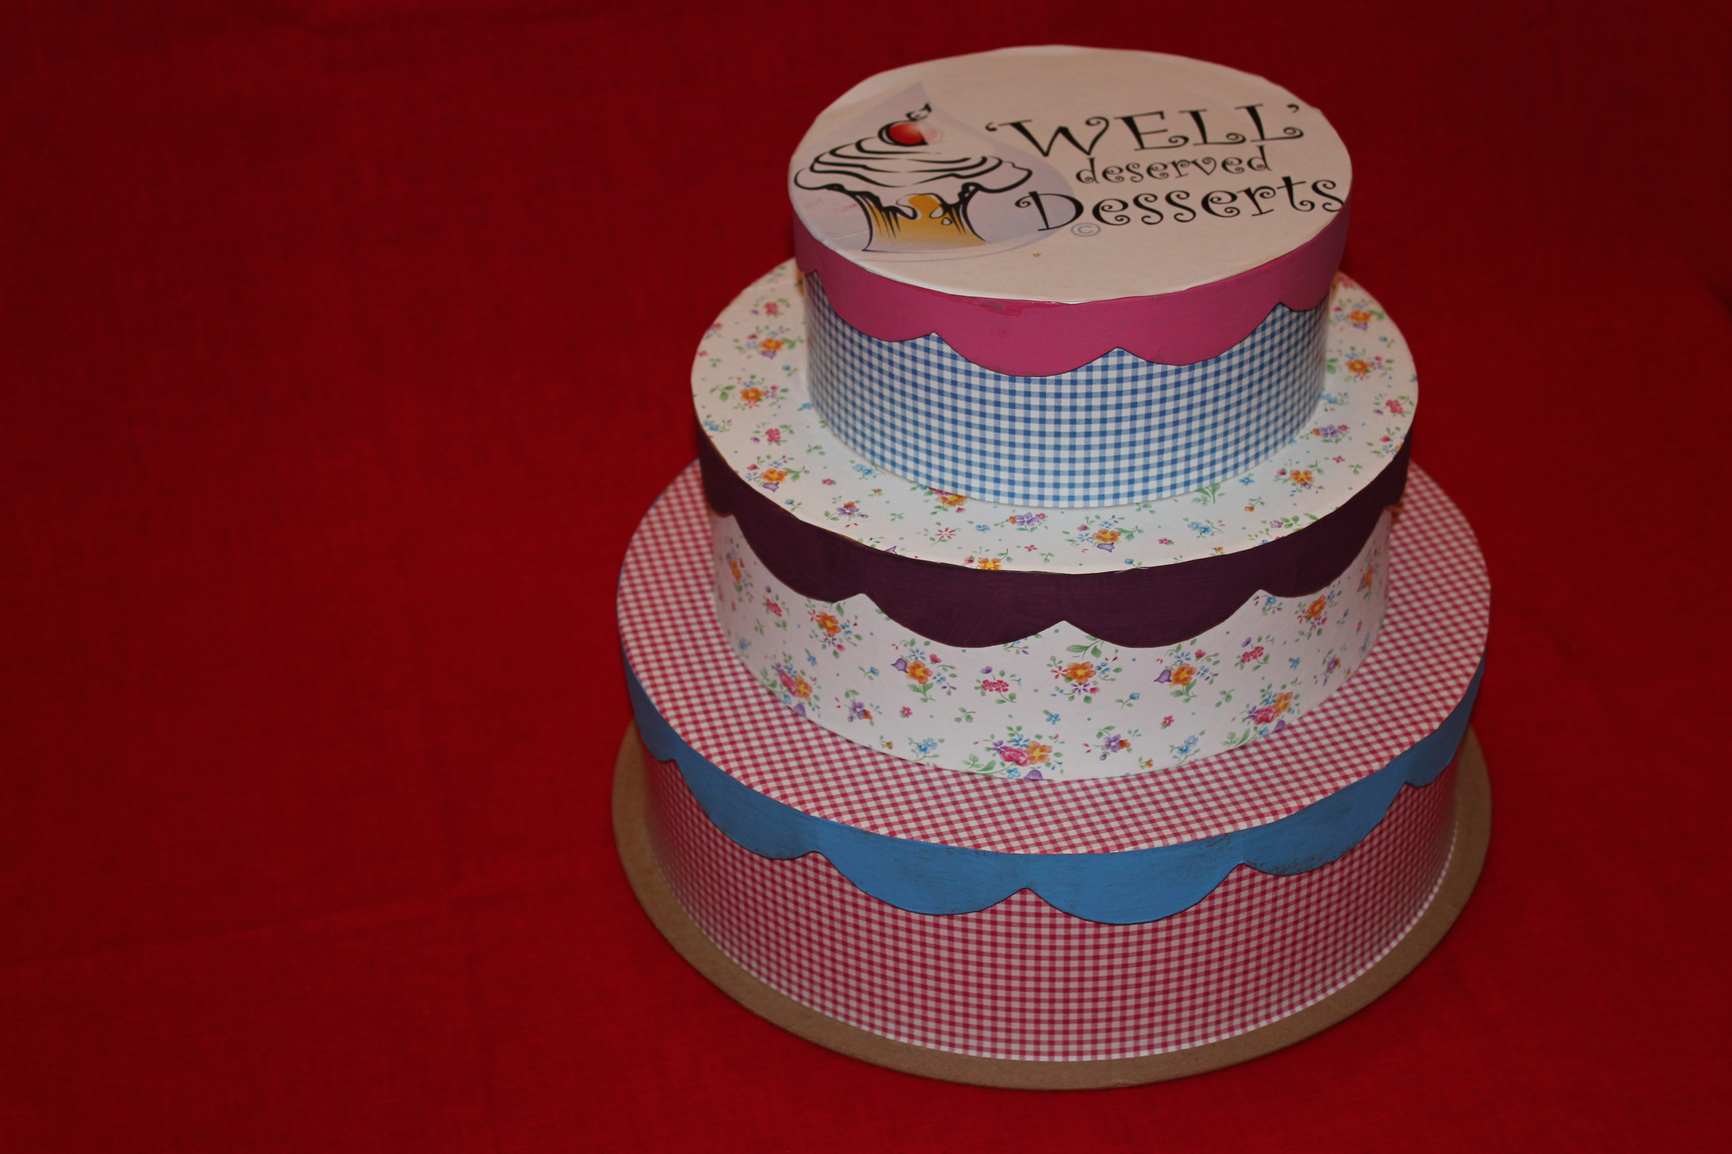
Triple Tiered Treats
The No Bake Event
How Does this Event Make Money?
Notes:
The first module, “Tripled Tiered Treats” was developed primarily as a no baking or cooking event.
The idea is to offering a sweet to those who participate by giving a donation to your fundraising cause by giving thank you gifts or “cake slices”
This module easily adaptable for big and small clubs
The concept is to get people excited about donating to the cause. The “cake and the gifts allow you to serve the donors a thank you gift (which we will refer to as the slice of cake) for their generosity
This recipe can be “served”
As a stand alone event. Consider adding a presentation about the project to spice up the event
Part of your club’s birthday coffee or luncheon
At the holiday bazaar

Slide 9
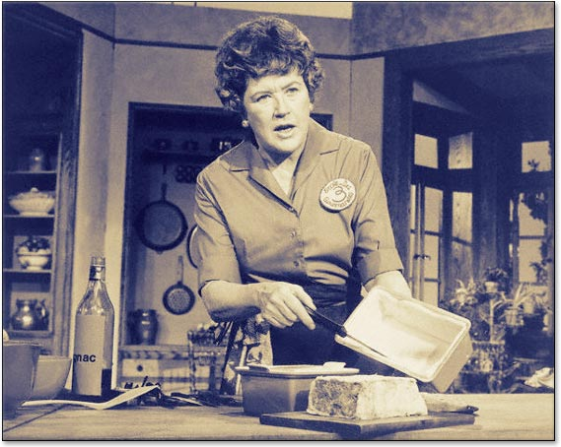
Making the “Cake”
Notes:
There are two major components for this module:
A cake- this is constructed out of boxes and decorated however you want Construct a three-layered cake Each layer represents a different donation level -the lower layers are larger in size and will be the smaller donations, the middle layer will be slightly higher donations and the top layer will be for the largest donations. Inside each layer will be envelopes or “slices”. Each slice will represent a “thank you gift” which is described inside the envelope

Slide 10
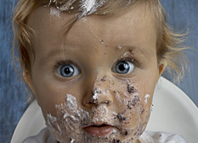
Making the “Filling”
Notes:
The filling consists of donated prizes ideas- merchandise, food, cookbooks, gift certificates
You will want to have your members who are good at asking for donations, or members who have something to donate (a cooking lesson? Does someone have a signature dish that they will prepare as a donation?
But there are no hard and fast rules. If you want to use non food related items, that will work as well.

Slide 11
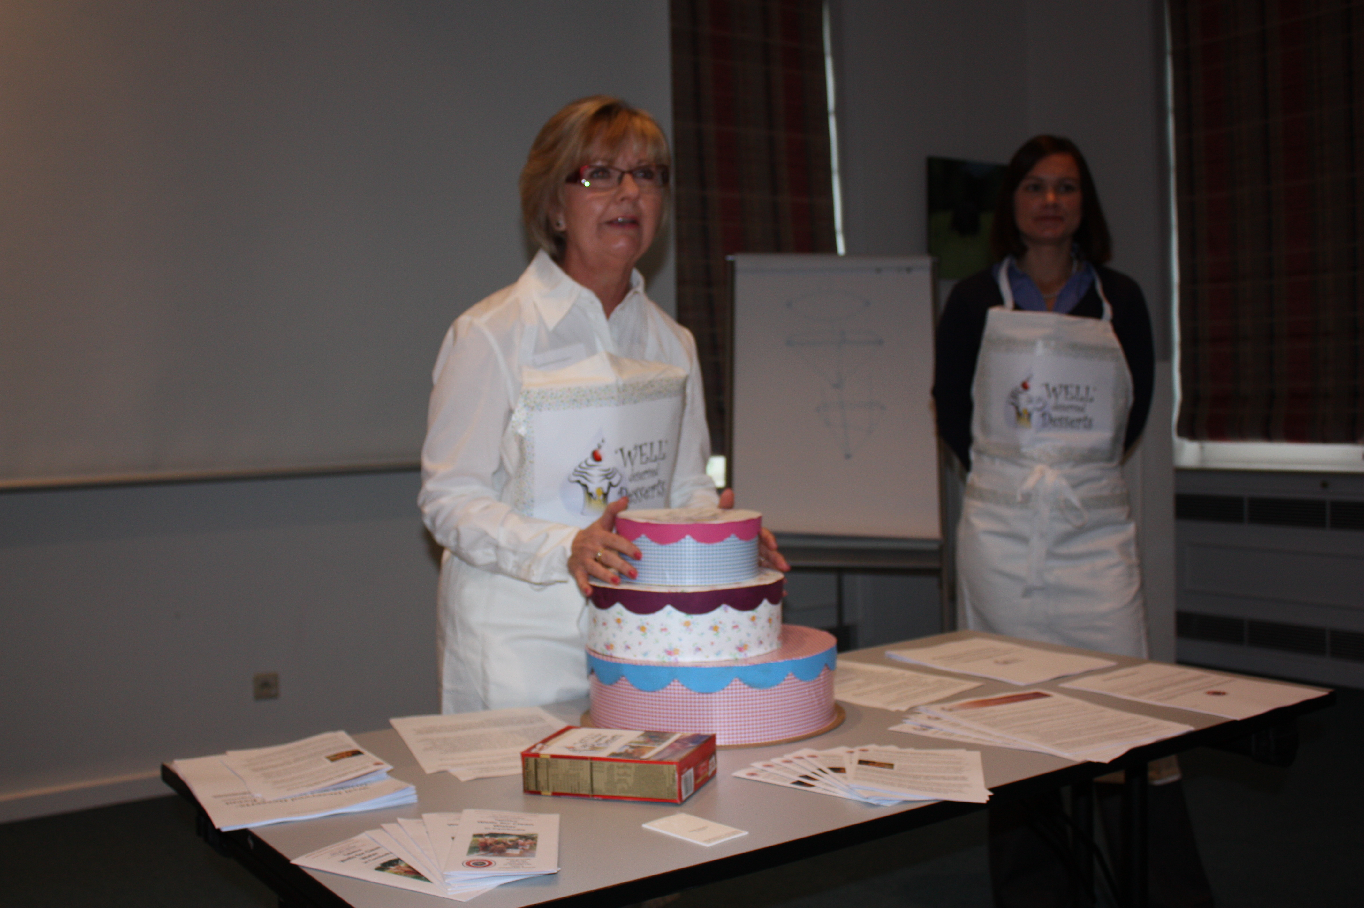
Triple Tiered Treats
“Baking” the cake
Notes:
We have had a number of requests to make a power point presentation on how to “bake the cake”- So here now for the first time ever- The no bake (no eat) cake recipe

Slide 12
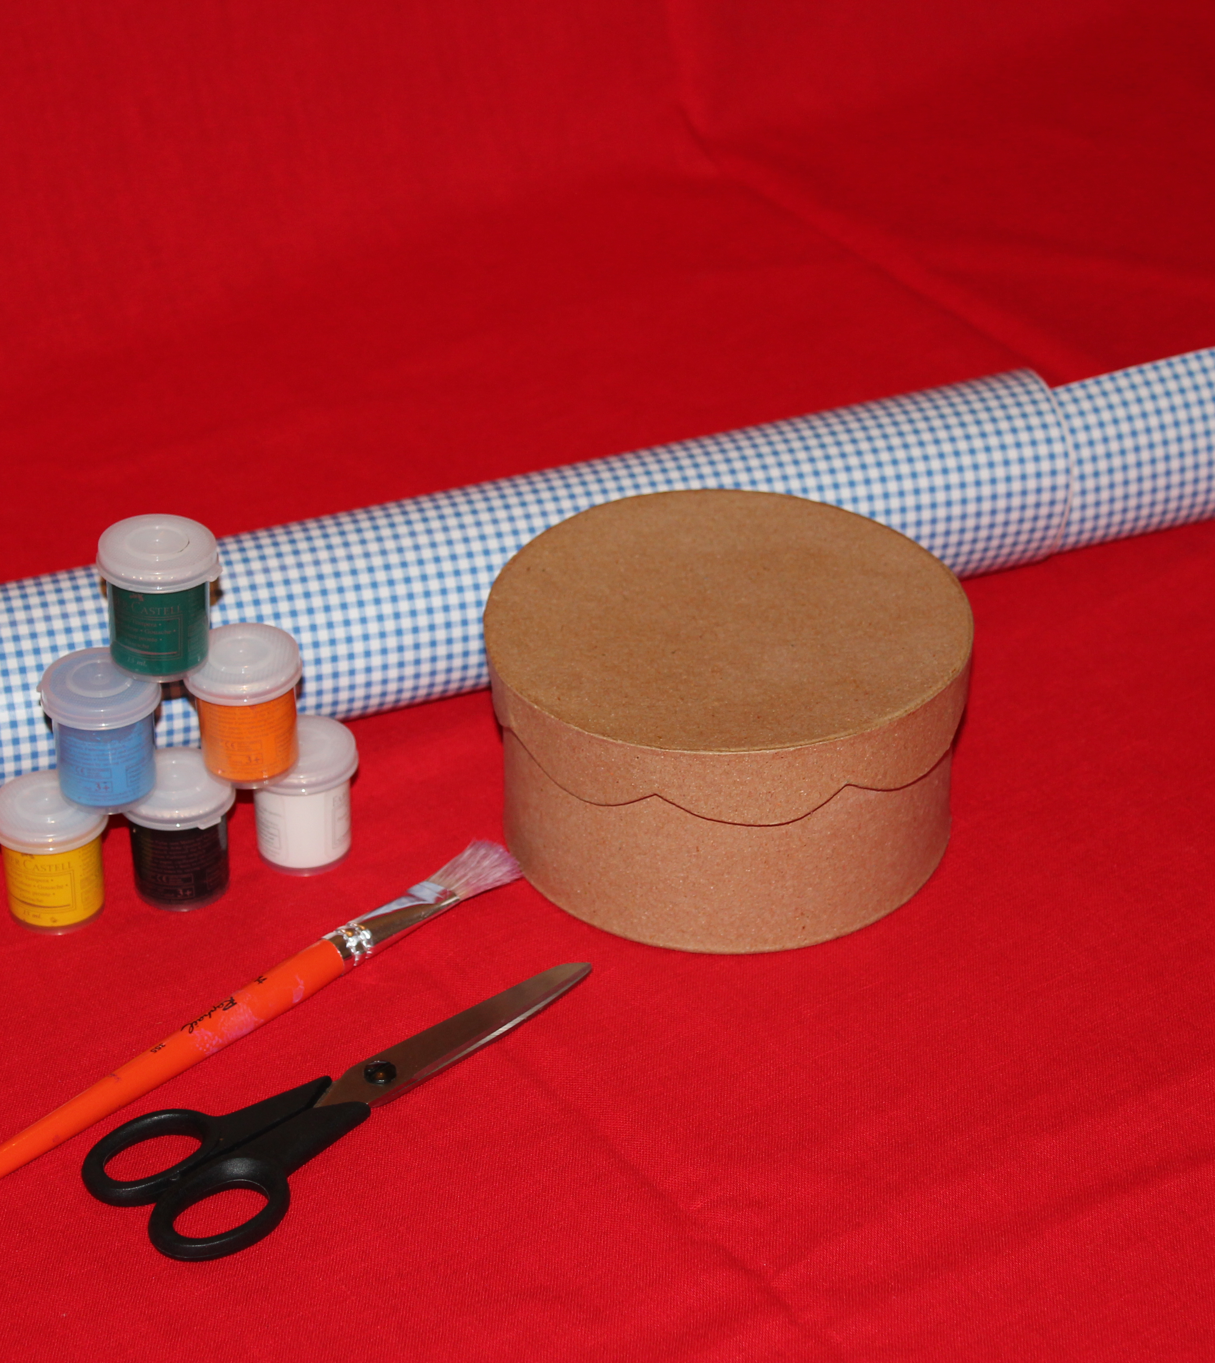
Triple Tiered Treats
Ingredients:
3-Card board boxes, preferable different sizes;
Paint, paper, whatever you want to use to decorate the layers
Small cards and envelopes (2 cards for every envelope)
Notes:
This is a a no fat treat for sure.
The task of making the cake layers can be a fun event in itself. Volunteers can design the cake to suit whatever theme you choose.

Slide 13
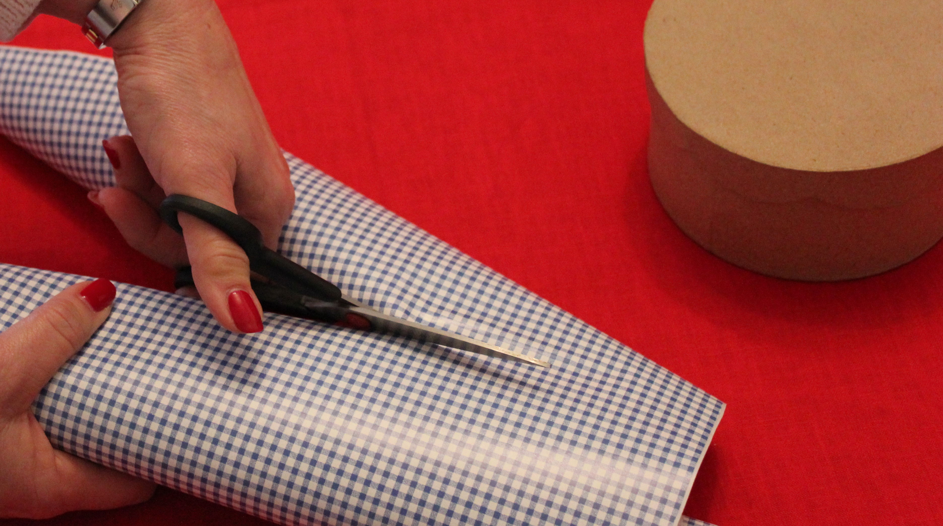
Triple Tiered Treats
MAGIC HANDS
Self adhesive paper
makes decorating a breeze!
Notes:
For the purposes of this presentation (and due to the artistic limitations of its author)
We are using self adhesive decorative paper but feel free to paint, decoupage or glitter-what ever inspires you!

Slide 14
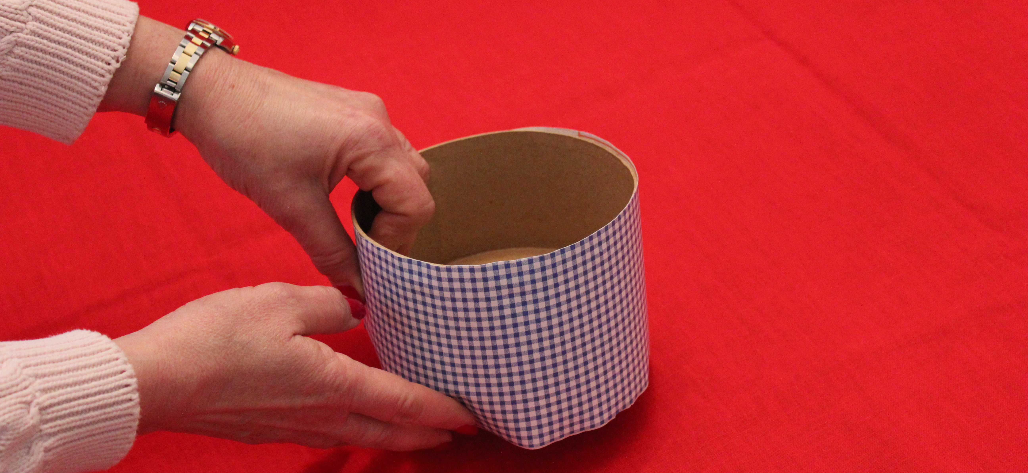
Triple Tiered Treats
MAGIC HANDS
Self adhesive paper makes
decorating a breeze!
Notes:
While there are only two hands working on this cake, there is no reason why the cake decorating couldn’t be a fun coffee morning (or for a difference, with wine in the afternoon!)

Slide 15
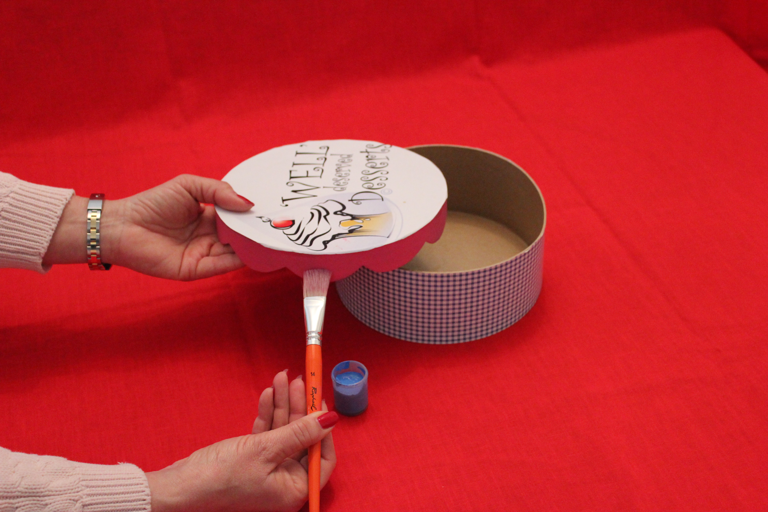
Triple Tiered Treats
MAGIC HANDS
Decorating the layer top
Notes:
This top was decorated with the well deserved desserts logo printed on paper and the sides were painted. You could use your club logo or a photo-whatever you want!

Slide 16
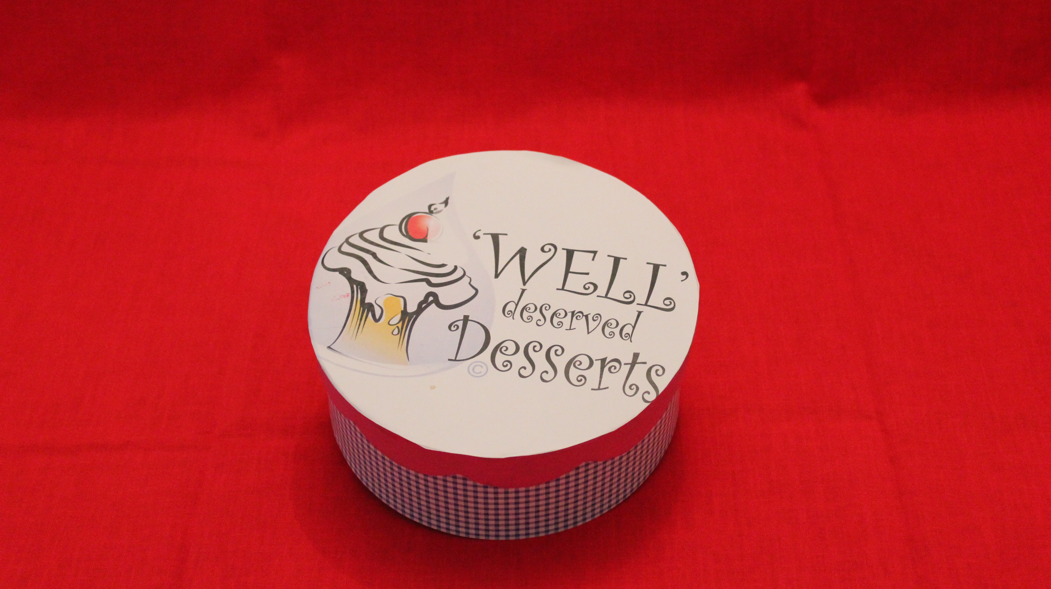
Triple Tiered Treats
VOILA!
Notes:
Ready for the filling!

Slide 17
Tripled Tiered Treats
Recipe Card The“Tiers”
Largest Layer
Minimum donation for a slice is $15.00 (5o slices)
Middle Layer
Minimum donation for a slice is $50.00 15 slices)
Top Layer
Minimum donation for a slice is $75.00 (10 slices)
TOTAL- 75 slices =$2600
Notes:
The filling as we mentioned earlier are items or services that have been donated.
Group the gifts based on value (this is not a science. You decide which gifts go in which layer!)
For example
We have developed a model for 75 donors that would yield $2600..
The largest layer-Minimum donation for a slice is $15 (50 slices). The gifts for these slices might include- some baked goods to take home, refrigerator magnets, and coffee mugs.
The middle layer-Minimum donation for a slice is $50 (25 slices). The gifts for these slices might include- more specialized baked goods, cookbooks, a small kitchen appliance or cooking utensils, etc,
The top layer-Minimum donation for a slice is $75 (10 slices). The gifts for these slices might include: a highly specialized baked item (fancy cake) a cooking class, tea for two at a local hotel, a very nice kitchen appliance, linens, and cake plates etc.
The format can be adjusted to suit your event; more slices different minimum donation levels, etc

Slide 18
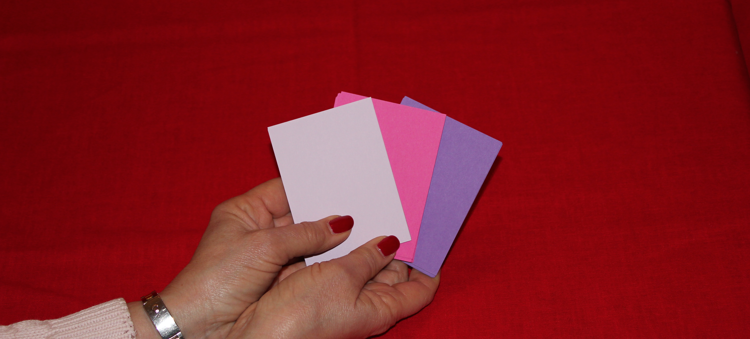
Triple Tiered Treats
Magic Hands-the Filling
Use different colored cards for each layer
Notes:
For each layer, select a different color card
Each gift will need 2 cards

Slide 19
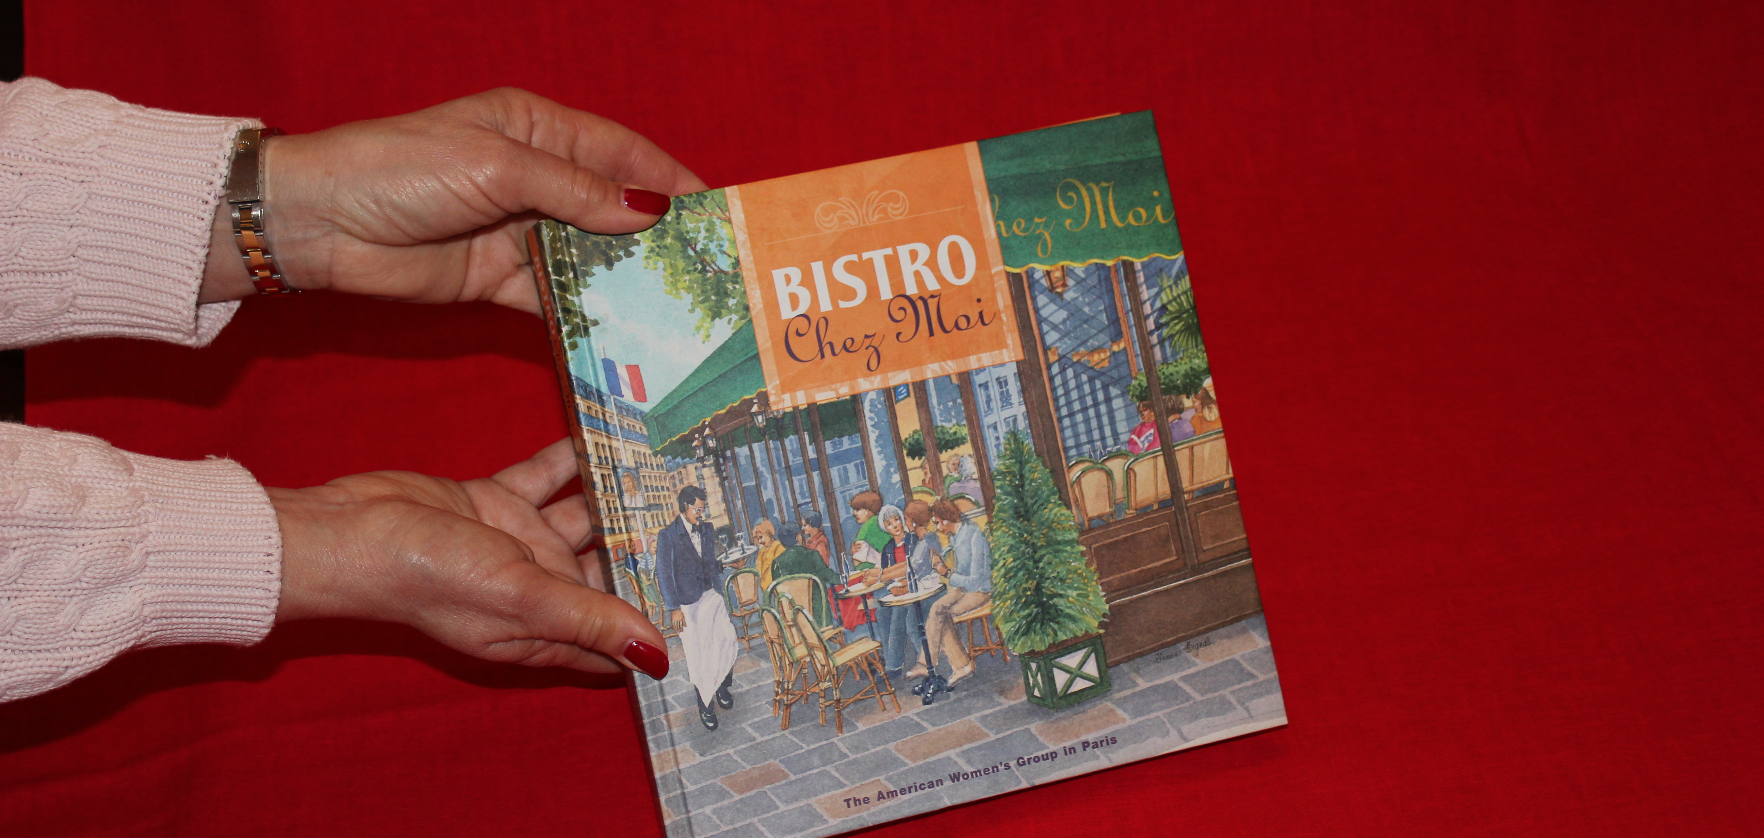
Triple Tiered Treats
Magic Hands-the Filling
A wonderful gift to say thank you!
Notes:
Here is our first gift! The best selling classic cookbook “Bistro Chez Moi” written published (and sold) by AWG Paris
A truly wonderful and highly sought after collectable cookbook

Slide 20
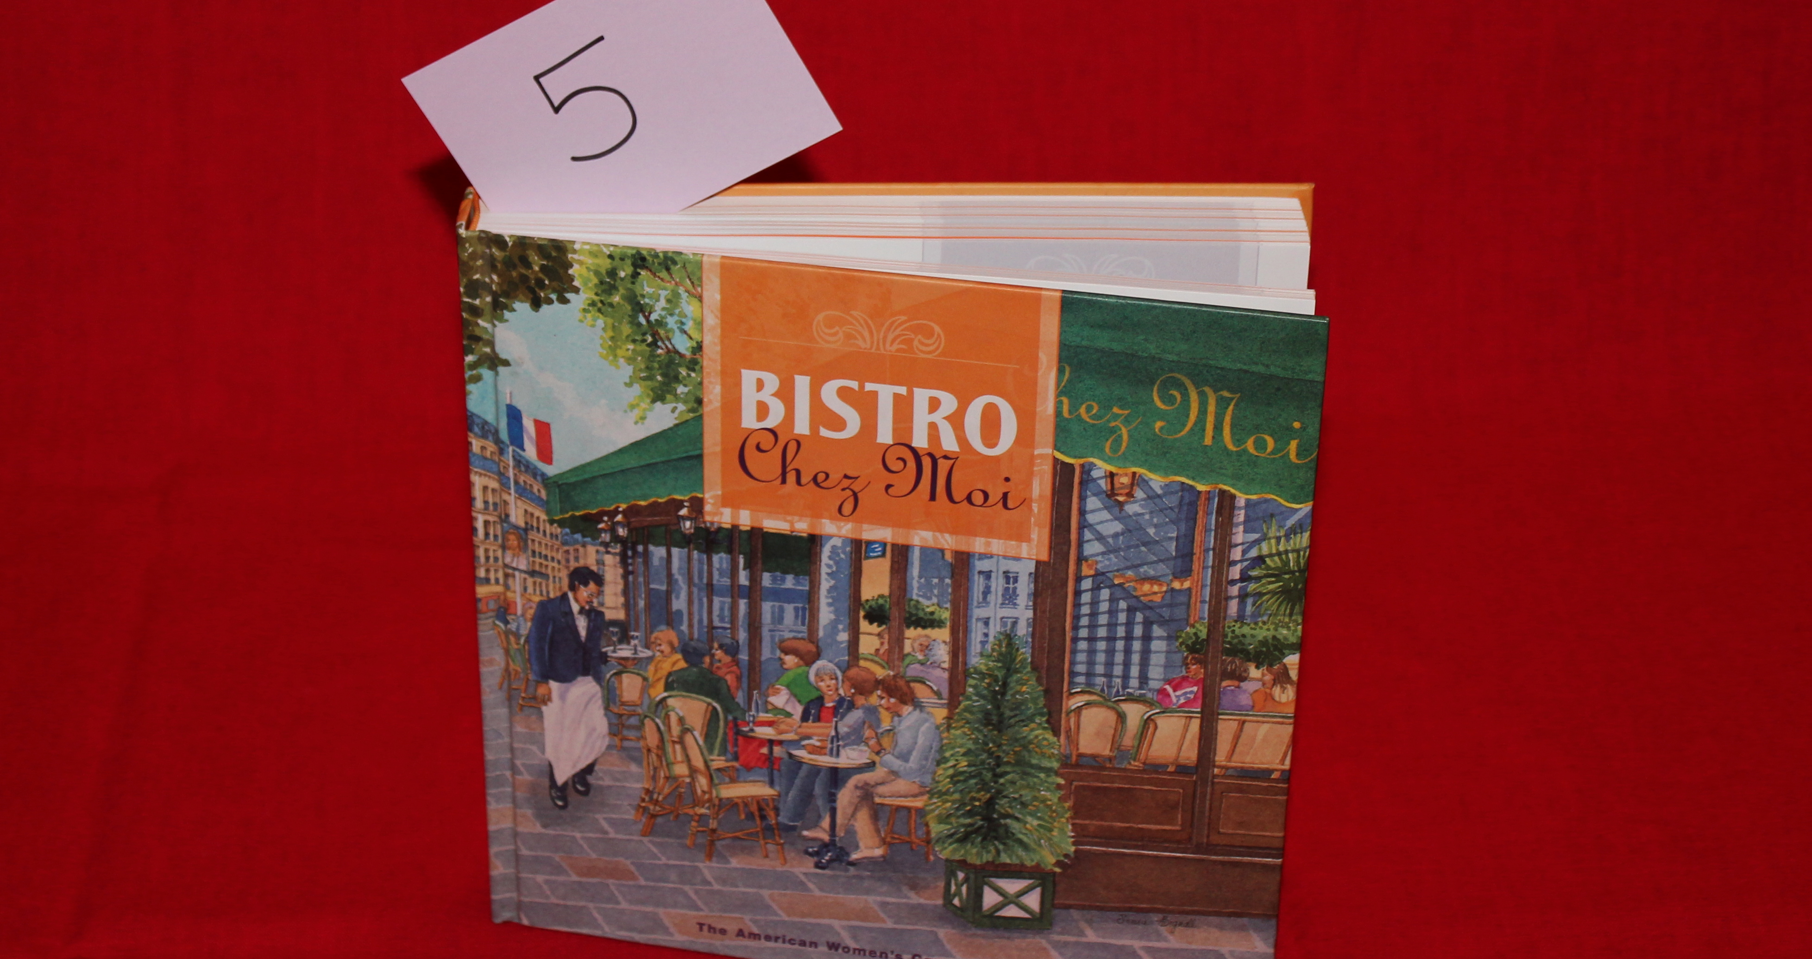
Triple Tiered Treats
Assign a number to the gift…
Notes:
This is “TOP TIERED” item to be sure.
We assign it a number (any number will do…) and write it on a card

Slide 21
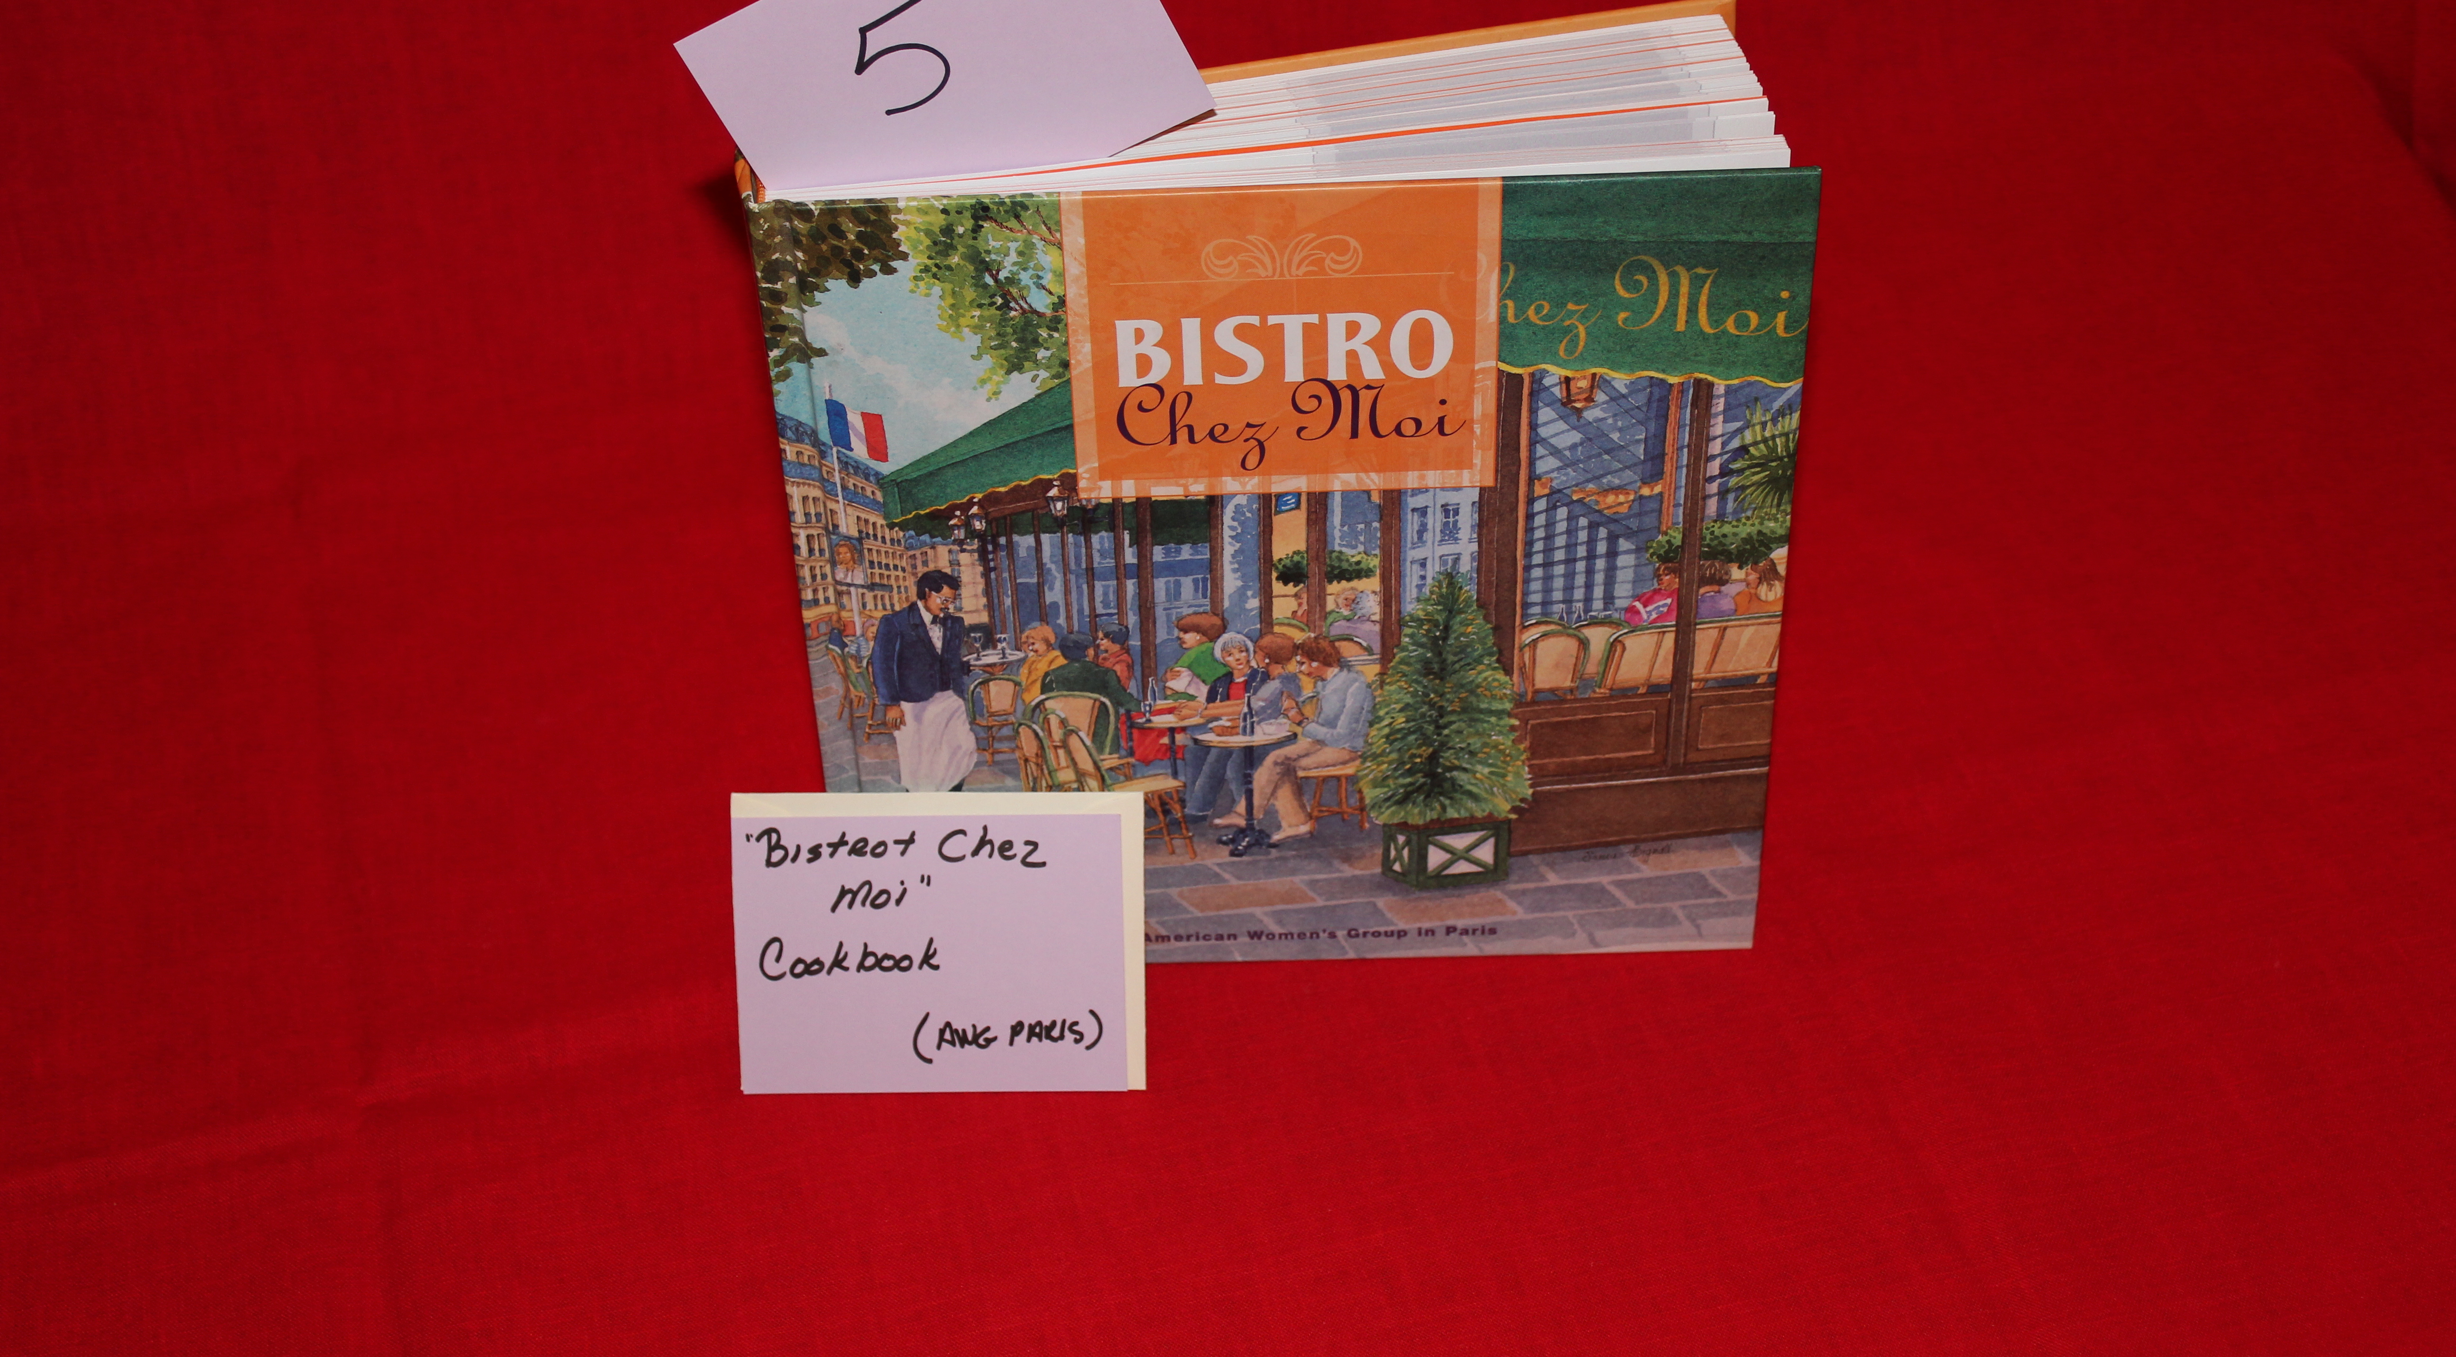
Triple Tiered Treats
Write a description of the gift on the second card…
Notes:
We take a second card-
We write the description of the item on the card…
On the other side of this description card

Slide 22
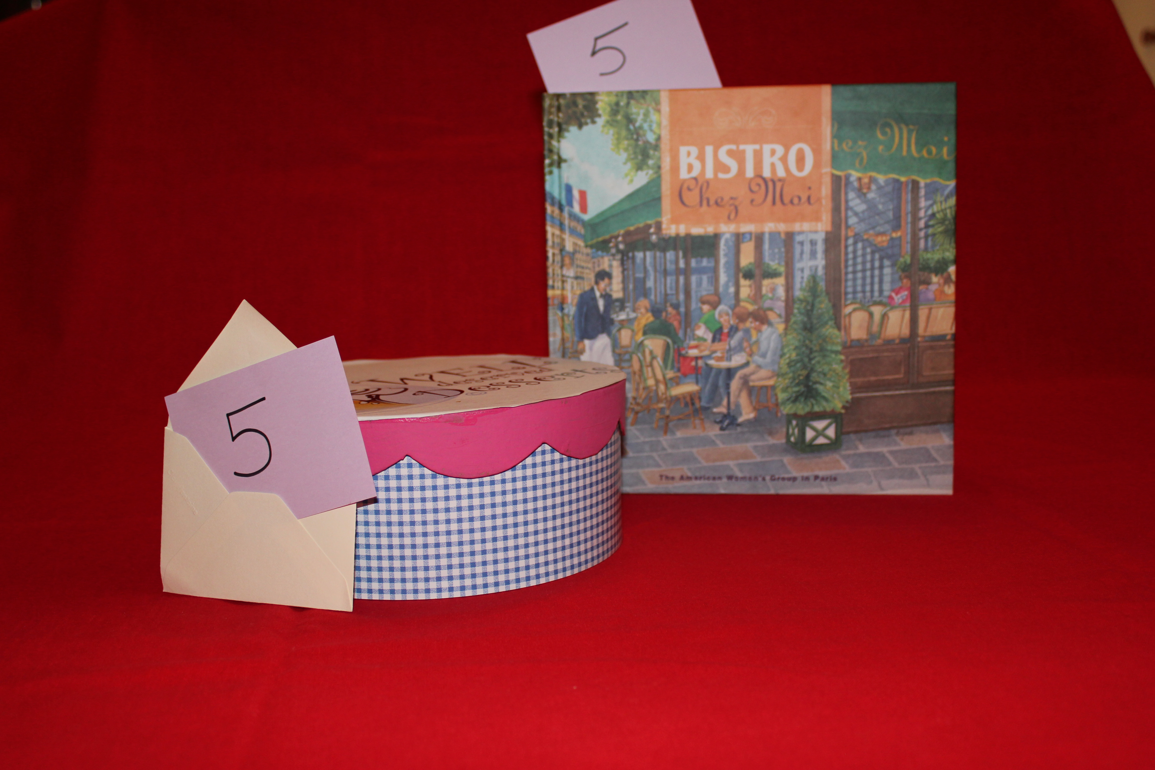
Triple Tiered Treats
Write the corresponding number on the front of the card…
Notes:
We write the same number We place that card in an envelope…

Slide 23
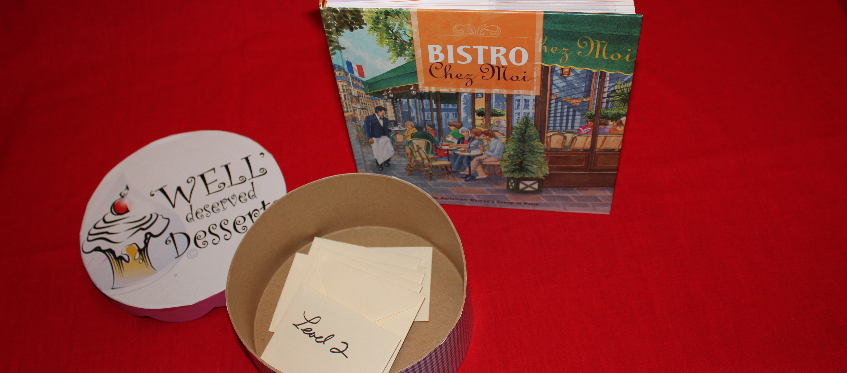
Triple Tiered Treats
Put the envelope in the appropriate layer …
Notes:
And place the envelope in the appropriate layer..

Slide 24
Triple Tiered Treats
Complete for the other layers and you are ready for your Tripled Tiered Treat Event!
Notes:
Once you have completed the cards and envelopes for each layer, you are ready to serve…

Slide 25
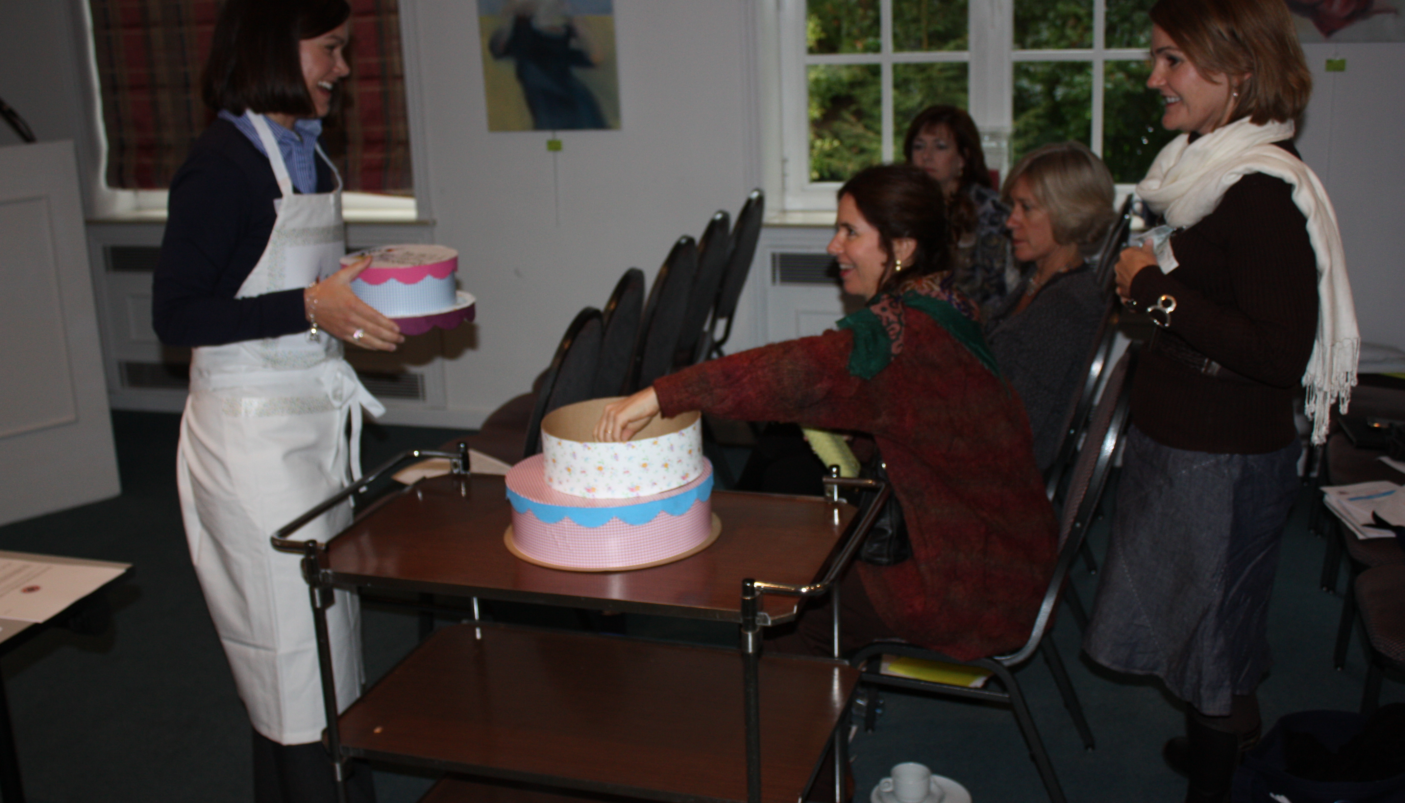
Triple Tiered Treats
Raising Money as easy as…cake!
Notes:
Set the gifts out on a table. If you have enough room, perhaps make one table for each layer’s gifts. Make sure that each gift has a number on it that corresponds to a number on a slice in the layer of cake. When a guest makes a donation, she is given one of the envelopes from the layer that corresponds to her donation. The donor then selects the gift described in her envelope.
Ask for a volunteer hostess. You can either get her a serving cart and the hostess can move from guest to guest to collect donations. Or you can have a station in the room and ask the guests to visit the hostess to make their donations and get their “slices” and to collect their gifts.

Slide 26
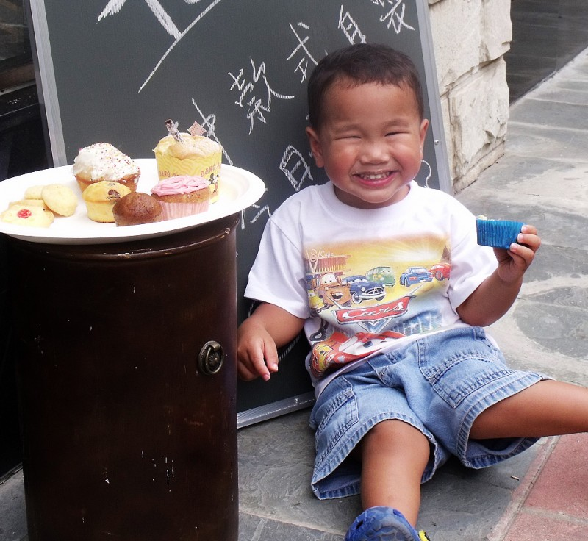
A Fundraising Campaign to
Support the FAWCO Target Water Project in Partnership with The FAWCO Foundation Benefiting
Tabitha Cambodia Wells for Clean Water
Recipe for Fun-Raising Success
1 Enthusiastic FAWCO Club
1 Mouth Watering Event
1 Very Important Project
Mix- Serve- SUCCESS!
Notes:
We hope this demonstration was as educational as it was fun!
Recipes for Fun Raising Success event preparation help kits are available on The Foundation’s Website.
Please take a few minutes, no take about 20 minutes, to read through the modules.
Like one? Great give it a try!
See something that you might want to adapt-adapt away! If we can’t guide you, perhaps we will inspire you.

Slide 27


The Mixing Bowl’s in Your Kitchen-Good Luck!
Notes:
The Well Deserved Desserts Campaign continues through December 2012. So start planning your event now.
Recognition Awards will be given for outstanding efforts at all levels. The final results will be announced at the FAWCO conference in March 2013.
Visit Foundation’s website often for updates and look for updates in The FAWCO Target Water Program monthly e-newsletter.
Thank YOU!

